Slide 1
Proposal
for an application
to solve food loss and waste
Team 5
Yuuki Katsumata, Rintaro Otani, Ryosei Seto, Rina Takagi, Yafangzhou Xu
Notes:
最後にページ数ふる
Hello, everyone. We are team5.
The purpose of this presentation is to let you know about proposal for application to solve food loss and waste.

Slide 2
Team 5
Issue
Index
1
How to solve
2
Target User
3
Product Overview
4
Demonstration
5
Conclusion
6
2
Notes:
I’ve (I have) divided my presentation into six sections.

Slide 3

Team 5
Issue
1
3
Notes:
To begin with, I’d (I would) like to give you some background about our product.

Slide 4


Issue
Team 5
food loss and waste from households
from households
from businesses
47% 53%
4
[1]Ministry o f Agriculture Forestry and Fisheries (2021)
Notes:
本インターンのテーマは、フードロスの解決に貢献するプロダクトの開発です。
フードロスは家庭系と事業系に大別できる。
我々は家庭形ロスに焦点を当てる。
The theme of this internship is to develop products that contribute to solving food loss and waste.
Food loss and waste can be divided into household and business losses.
We focused on household losses, which are more familiar and easier to imagine.

Slide 5

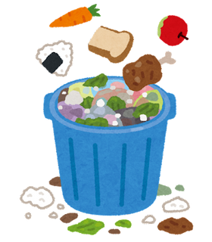

Food loss and waste from households
Team 5
direct disposal
excessive removal
leftovers
Foods that are not consumed
before expiration dates and disposed
Foods that are edible but disposed together with inedible parts during preparation (i.e. excessive peeling)
Foods that can not be finished in one meal
43%
14%
43%
Focus on "direct disposal"
5
[2] Ministry of the Environment (2021)
Notes:
家庭形ロスはさらに3つに分けられる。
我々は直接廃棄に焦点を当て、この課題を解決するプロダクトの開発を目指す。
Food loss and waste form households can be further divided into three categories.
We focus on "direct disposal" and aim to develop products that solve this issue.

Slide 6

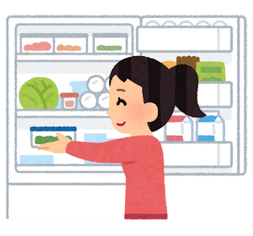


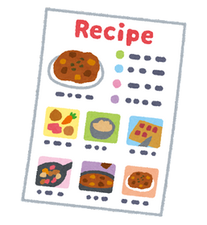

What causes direct disposal?
Team 5
Overbuying
Improper storage
EXPIRED
Forgetting date label
Not knowing recipes
[3] Ministry of the Environment
[4] Food and Agriculture Organization of the United Nations
6
Notes:
There are 4 main factors that cause direct disposal.
First, overbuying more than necessary.
Second, Improper storage.
Third, forgetting the expiration date label.
Finally, not knowing recipes.

Slide 7
Team 5
How to solve
7
Notes:
Secondly, I’m going to talk about how to solve this issue.

Slide 8
How to solve
Team 5
Causes of direct disposal
Overbuying food
Improper storage
Forgetting date label
Not knowing recipes
The aim is to help users who have the above problems.
We plan to prevent unnecessary disposal and overbuying by
providing recipes to consume the food
recording expiration dates
sending notifications of expiring food.
8
Notes:
Within the 4 main causes of direct disposals, we mainly focused on two causes: overbuying food and forgetting expiration dates. We aim to help people who have these two problems.
we planned to prevent unnecessary disposal and overbuying by providing recipes to consume the food, recording expiration dates and sending notifications of expiring food.

Slide 9
Team 5
Target User
9
Notes:
Thirdly, we will move on to target user.

Slide 10
Target User
Team 5
People who:
Cook but struggle with managing food
Want to save the time of coming up with recipes.
Struggle with using up all ingredients
Want to reduce expenditure on food
10
Notes:
アプリの目的＝食品ロス削減
アプリ使うユーザーの目的・同期
＝？
アンケートデータで需要を示す
we aim to target at people who

Slide 11
Team 5
Product Overview
11

Slide 12

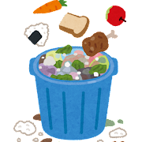

Product Overview
Team 5
Our app reduces unnecessary shopping and disposal by letting users manage household food stock
12
Notes:
アプリの目的＝食品ロス削減
アプリ使うユーザーの目的・同期
＝？
アンケートデータで需要を示す

Slide 13







System Overview
Team 5
Devices
Web server
Database
Record food information
Take photos of receipts
Edit stock information
Display recipes
Display graphs
OCR(OCR on images of receipts
post-process the captured characters
Recommendations from Rakuten Recipe
Update expiration dates
Stock information
Knowledge base of expiration dates
Recipes
13

Slide 14
Team 5
Demonstration
14

Slide 15
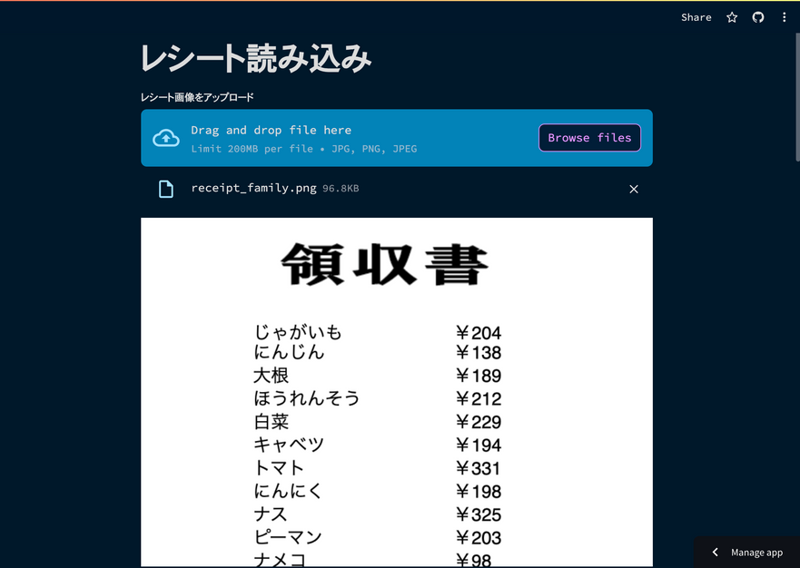
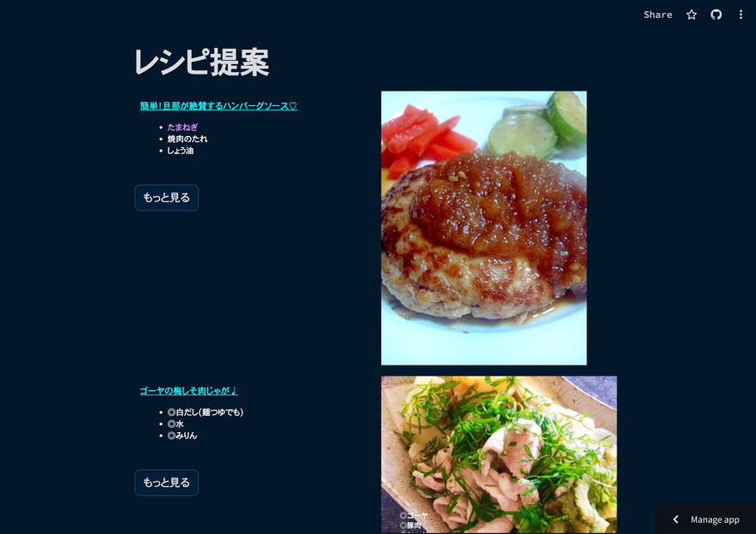
Technical DevEffort
Team 5
Foods can be read from receipts
Recommend recipes using ingredients that are close to their expiration date
Easy-to-read UI on smartphones
Visualize graphs on the home screen
Using existing API for fetching recipes
15

Slide 16
Team 5
Conclusion
16

Slide 17
Slove Issues?
Team 5
Solved by these functions！
Issue
Over buying
Improper storage
&Forgetting date label
Not knowing recipes
App function
Stock management
Notification
Recipe suggestions
17

Slide 18
Future prospects
Team 5
To implement a login form
Password
Duplicate username
To improve design quality
Use more flexible framework (ex. Django)
To implement as a smartphone application
18
Notes:
There are two main functions that should be added in the future.
First, to improve security, implement a login form that uses a password.
Second, to improve design quality with a more flexible framework.

Slide 19
Role
Team 5
Katsumata (leader)
Task management
Code check
Otani
Recipe page
Reciept page
Seto
Home page
Stock page
Takagi
Presentation slide
Database function
Xu
Reciept page
OCR function
19
Notes:
The roles is this.

Slide 20
Reference
Team 5
[1] 農林水産省 日本の食品ロスの状況（令和３年度）
https://www.maff.go.jp/j/press/shokuhin/recycle/attach/pdf/230609-2.pdf
[2] 環境省 発生要因の内訳（令和３年度）
https://www.env.go.jp/content/000138776.pdf
[3] 環境省 食品ロスを減らすために、私たちにできること
https://www.env.go.jp/recycle/foodloss0215.pdf
[4] Consumer Food Waste | Food Loss and Waste in Fish Value Chains |
Food and Agriculture Organization of the United Nations
https://www.fao.org/flw-in-fish-value-chains/value-chain/consumption/consumer-food-waste/en/
20

Slide 21
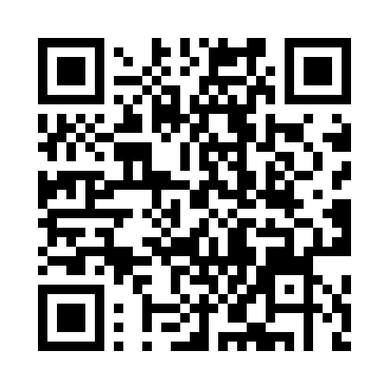
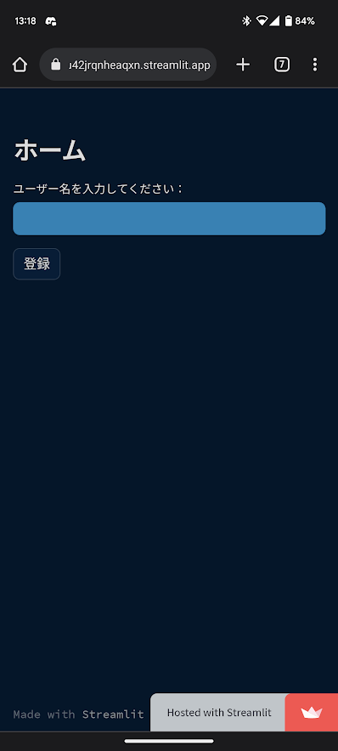
Thank you for listening !
Team 5
Please register a unique name
Scan this QR code.
We think you will enjoy the demo!
21

